Slide 1
Creativity & Innovation
BM006-3-2-CRI (VC1) 1st April 2018
Lecture 5:
Idea Generation Techniques Part 2 of 3

Slide 2
Topic Learning Outcomes
To evaluate and interpret different concepts and principles in idea generation;
  Morphological
  Force fitting trigger

Slide 3
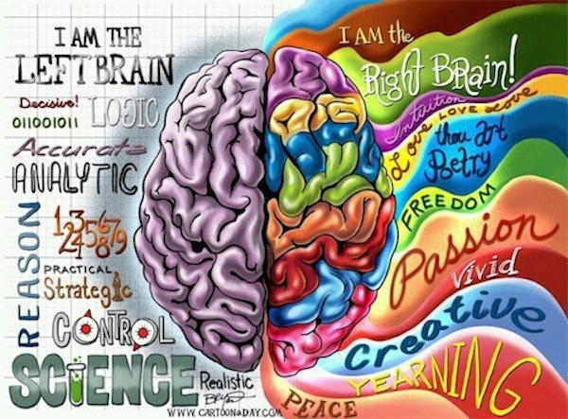

Slide 4

How Nairobi Is Earning Its Nickname as the Developing World's 'Silicon Savannah'
Kenya's capital city is quickly becoming a technology epicenter. An agile mobile banking system is creating new market opportunities for digital entrepreneurs
Source: http://www.inc.com/zoe-henry/nairobi-kenya-startup-hot-spot.html

Slide 5
Ideation (Idea finding)
Analytical Techniques
Morphological analysis /method
Morphological analysis is a technique developed by Fritz Zwicky (1966, 1969). for exploring all the possible solutions to a particular technical problem.
In linguistics it refers to identification of a word-stem from a full word-form.
As a problem solving technique, morphological analysis was designed for multi-dimensional, non-quantifiable problems where causal modeling and simulation do not function well or at all. Fritz Zwicky developed this approach to address seemingly non-reducible complexity.

Slide 6
Ideation (Idea finding)
Morphological analysis /method
A tool that can help generate a vast number of ideas
Works best as a visual aid
Not so effective where problem is complex
Problem should have two or three dimensions that will allow the construction of two or three dimensional grids
Possible dimensions listed which describes the problem or system studied.
No more than 3 dimensions.
Must be relevant and have logical interrelationship (e.g. if organisation seeks to alter product – may consider product shape and material use – 2 D)

Slide 7
Ideation (Idea finding)
Morphological analysis /method
A list of attributes is generated under each dimension. Ideas encouraged (does not have to be causal in nature)
Examine combinations of attributes across the dimensions.
Evaluate each combination to determine the suitability.
May want to put a cross on each that has potential.

Slide 8
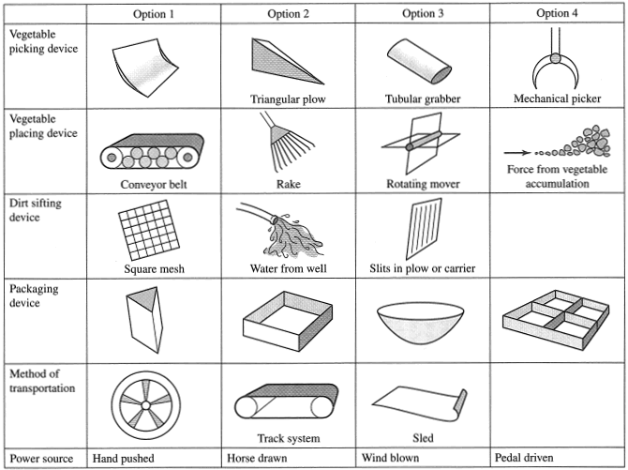
Morphological Analysis for vegetable collection system with selections (Haik and Shahin 2011)

Slide 9
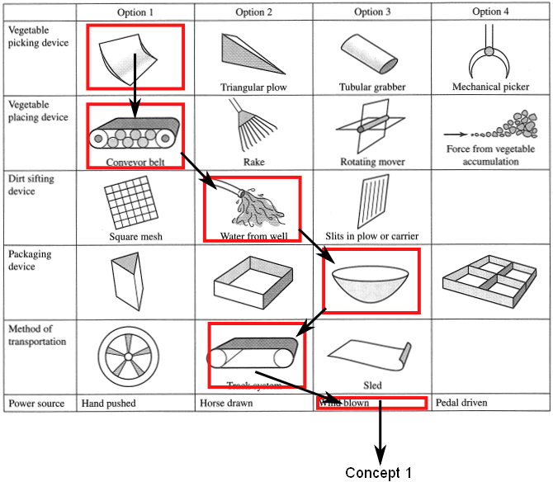
Source: http://cuba.coventry.ac.uk/maedesign/concept-design/l1-sketching-brainstorming-ideas-and-morphological-analysis/l1-morphological-analysis/

Slide 10
Your first few concept designs should follow different routes through the Morphological Matrix, that is why you have compiled it. Do not ignore it. In this instance;
Concept 1 could be – scoop > conveyor belt > water from well > bowl > track system > wind blown
Concept 2 could be – triangular plow > rotating mover > water from well > wheel > hand push
Concept 3 could be - scoop > conveyor belt > square mesh > wheel > hand push

Slide 11
Once you begin to combine these ideas, you’ll gain momentum and start to generate lots of ideas, organise your thoughts, change, erase, scrap, retrieve from bin, enthuse, destroy and generally go through the generation process.
The image below is a very good example of how you might sketch a number of alternatives to investigate different concepts.

Slide 12
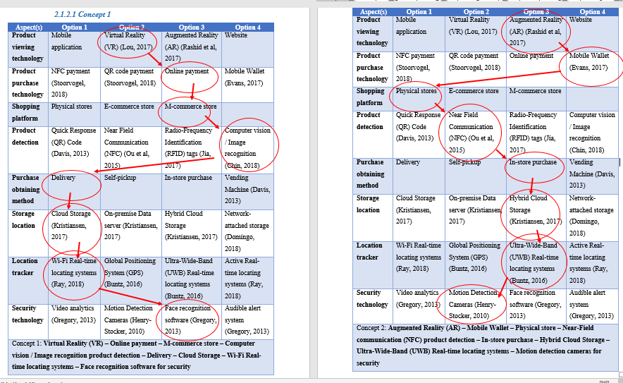
Ng Pei Jia : Quick Grocer – a mobile application and grocery vending machine

Slide 13
Ideation (Idea finding)
Force Fitting Triggers
Providing visual stimuli to help spark ideas in the mind
Force fit combinations of attributes that one associates with an unrelated object to the problem with which one is preoccupied.
Need a set of trigger cards on which are depicted pictures or drawings of well known objects and a flip chart which one records the attributes generated and the subsequent implications for the problem itself.

Slide 14
Ideation (Idea finding)
Force Fitting Triggers (Problem Given)
You are working on the problem of improving interdepartmental communications
Using the triggers generated, suggest ideas.

Slide 15
Ideation (Idea finding)
Force Fitting Triggers
Choose three trigger cards showing different pictures and draw a column for each on a different chart
Call out the first thing that comes to mind when you think of the item on the trigger card. Fill each column on the chart with these ideas.
Describe the problem to be solved. Find solutions which make use of at least one word from each of the three columns.
Move from less sensible to sensible solutions.

Slide 16
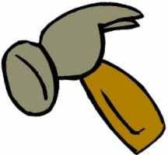
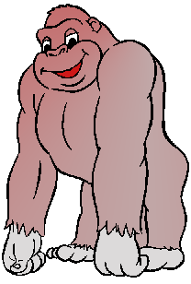

Ideation (Idea finding)
Force Fitting Triggers (Trigger Cards)

Slide 17
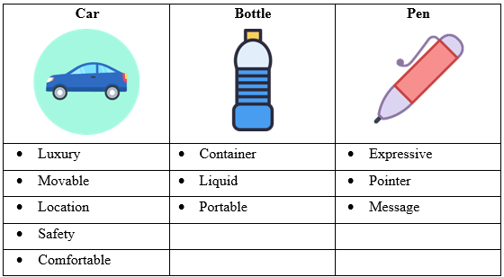
 | Combinations | Outcomes
1 | Location (GPS) + Message (Notifications) + Portable (Mobile) + Expressive (Picture) | A mobile application that takes a picture and accesses GPS location of the mobile to track injured stray dogs or cats.
2 | Comfortable + Container (House) + Message (Notifications) | A pet house built for stray dogs or cats at roadside. When the strays come in, the house will notify the system to give them some foods or water. Indirectly, the system can record the number of strays in a particular area through the number of entering of animals.
Source: Kong En Yi (TP041168), CapTrack Application
‹#›

Slide 18
Question and answer session
Q & A
Slide <<number>> of 13

Slide 19
What we will cover next
To evaluate and interpret different concepts and principles in idea generation;
  Mind-mapping
  Lotus blossom
  Concept fan
Slide <<number>> of 13

Slide 20
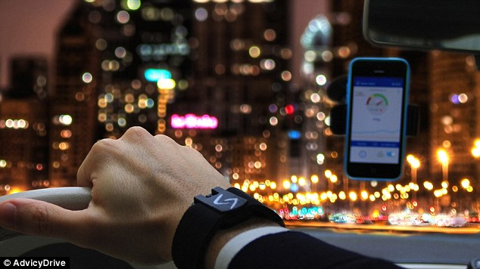
The bracelet that could prevent car crashes: AdvicyDrive tracks heart rate and rings an alarm when you start to nod off at the wheel

Slide 21
The bracelet that could prevent car crashes: AdvicyDrive tracks heart rate and rings an alarm when you start to nod off at the wheel
AdvicyDrive monitors heart rate while driving to tell how awake you are
If it detects a drop in heart rate, which suggests you're dozing off, it sounds an alarm on a connected smartphone
It uses digital photoplethysmography (PPG) to track changes in blood flow
Sensor can be fitted to a wrist but will also clip to a person's underwear
Clip is under development and will launch via a crowdfunding site 'soon'
By Victoria Woollaston for MailOnline
Published: 17:09 GMT, 19 March 2015 | Updated: 07:40 GMT, 20 March 2015
Read more: http://www.dailymail.co.uk/sciencetech/article-3002758/The-bracelet-prevent-car-crashes-AdvicyDrive-tracks-heart-rate-rings-alarm-start-nod-wheel.html#ixzz3VAaGKDO3
Follow us: @MailOnline on Twitter | DailyMail on Facebook

Slide 22
Activity
Idea generation technique
  Morphological analysis
  Force Fitting Triggers
  Heuristic Ideation Technique
Choose one technique and generate ideas on products on how to prevent traffic accidents.

